Slide 1

Free Python and Django workshop
for women in Brno, February 2015

Slide 2
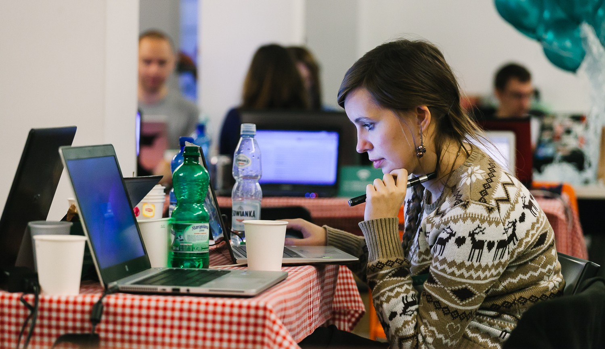
About
5th February 2014
Brno, Czech Republic
Django Girls is an initiative that is aiming
to introduce 30 women who've never coded before to the world of technology and increase the diversity. Right before DevConf.cz 2015 in Brno, we’re going to organize an one-day workshop and invite girls from all over Europe to join us and learn how to build the internet using HTML, CSS, Python and Django.

Slide 3
Target
Date & place
Supporters
30 women who never programmed before but are motivated to get into field, and who would share their experience with others
Full day, 5 February 2015
Brno University of Technology, Faculty of Information Technology
(hosted in the Red Hat office at the university)
We have already partnered with 10 awesome coaches, DevConf.cz, and Red Hat Czech!

Slide 4
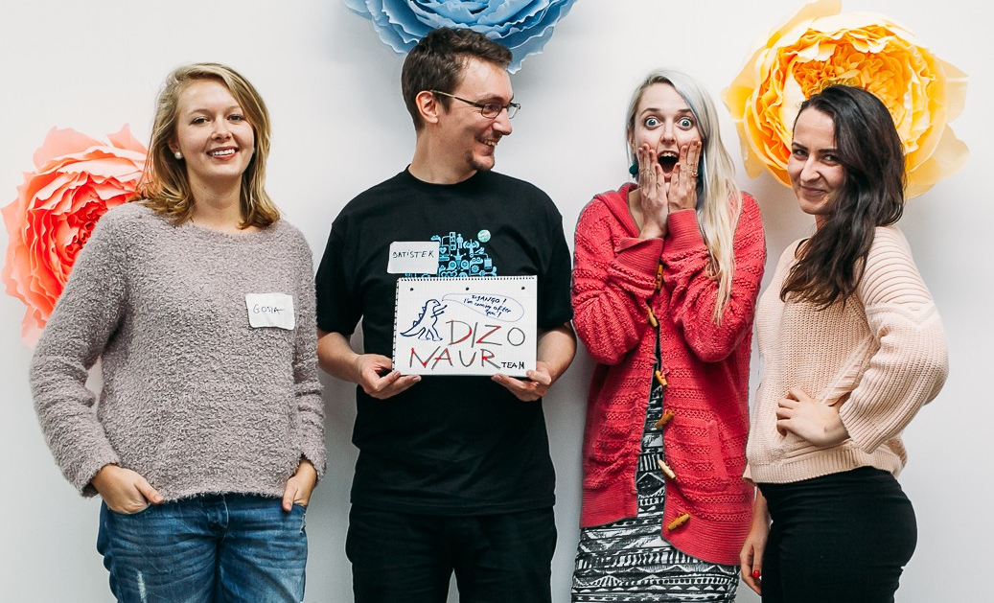
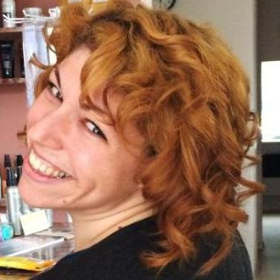
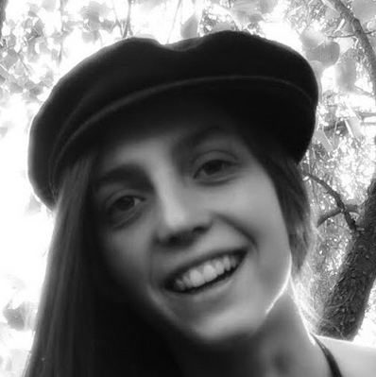
Team
Django Girls is organized by Mikey Ariel and Lenka Moutelíková from Brno. Mikey and Lenka both graduated from the first Django Girl workshop at EuroPython 2014, and they are excited about sharing what they learned and giving other women the same opportunity that they were given!
@thatdocslady
@enigmatahari

Slide 5

SUPPORT US!
We’re looking for kind souls and organizations that support the goal of bringing more women into technology to help us.
With every sponsor, we can bring more and more women from to come to Django Girls and DevConf.cz to learn about programming. Your money will go towards their travel financial aid, food and supplies during the workshop, and other necessary expenses to make the workshop a welcome, fun, and friendly place for these newcomer women!
Every women at Django Girls Brno will also have the opportunity to attend DevConf.cz. Even though the conference is free and will also provide some support to our attendees, those who qualify for financial aid will receive help with accommodations and expenses during the conference.

Slide 6
SUPPORT US!
You can help us in three ways:
800 €
500 €
300 €
company logo on website
company poster at workshop
send e-mail to attendees
5-minutes Lightning Talk
company logo on website
company poster at workshop
send e-mail to attendees
company logo on website

Slide 7
Thank you! ♥
djangogirls.org/brno
@djangogirlsbrno
Get in touch:
brno@djangogirls.org

